Slide 1
Employee Data Analysis using Excel
STUDENT NAME: HARANIYA V
REGISTER NO: 312216934
DEPARTMENT: BCOM (GENERAL)
COLLEGE SHRI KRISHNASWAMY COLLEGE FOR WOMEN

Slide 2
PROJECT TITLE
Salary and compensation analysis through excel data modelling

Slide 3


AGENDA
Problem Statement
Project Overview
End Users
Our Solution and Proposition
Dataset Description
Modelling Approach
Results and Discussion
Conclusion
3/21/2024 Annual Review

Slide 4

PROBLEM STATEMENT
Problem Statement: Salary and Compensation Analysis through Excel Data Modeling
Objective: To analyze and model salary and compensation data to understand pay structure, identify disparities, and inform compensation strategies.
Context: A company needs to evaluate its compensation practices to ensure competitive, equitable, and strategic pay structures. The analysis will help in making data-driven decisions regarding salary adjustments, compensation packages, and overall human resources strategies.
Problem:
Data Organization:The company has collected salary and compensation data across various departments, job titles, and employee levels, but the data is scattered and needs to be organized systematically.
Data Accuracy:There might be inconsistencies and errors in the data such as missing values, duplicate entries, or incorrect information that need to be cleaned and corrected.
Outcome: To provide a comprehensive understanding of the company’s compensation structure, identify areas for improvement, and support strategic decision-making regarding salary and benefits.

Slide 5

PROJECT OVERVIEW
Objective: To analyze and model salary and compensation data to assess the fairness, competitiveness, and effectiveness of the current compensation structures. This analysis will help the organization make informed decisions about salary adjustments, compensation packages, and overall HR strategies.
Scope:
Data Collection: Gather data on employee salaries, bonuses, benefits, and other compensation elements.
Data Cleaning: Prepare and clean data to ensure accuracy and consistency.
Deliverables:
Data Organization: A well-structured dataset with accurate and complete compensation information.
Descriptive Analysis: Summary statistics including average salaries, salary ranges, and distributions.
Methodology:
Data Collection: comprehensive compensation data from HR systems or databases.
Data Preparation: Import data into Excel Clean the data to correct errors, remove duplicates, and handle missing values.

Slide 6

WHO ARE THE END USERS?
ChatGPo mini
End users of salary and compensation analysis through Excel data modeling typically include:
Human Resources (HR) Managers: They use the models to develop fair compensation strategies, analyze salary trends, and ensure competitive pay scales.
Finance Teams: They leverage the data to budget for salaries, forecast future compensation costs, and ensure alignment with overall financial plans.
Compensation Analysts: They analyze salary data to design and manage compensation structures, perform market comparisons, and adjust pay scales accordingly.
Executives and Senior Management: They use the insights to make strategic decisions about compensation policies and to ensure that the company's compensation practices align with its business objectives.
Recruiters: They use compensation data to set competitive salary offers and attract top talent.
These users rely on Excel models for their flexibility, ease of use, and ability to handle various data types and complex calculations

Slide 7
OUR SOLUTION AND ITS VALUE PROPOSITION
Solution: Salary and Compensation Analysis through Excel Data Modeling
Data Collection: Gather data on employee salaries, roles, experience, performance, geographic location, and other relevant factors. This can be done through HR systems, surveys, or other data sources.
Data Organization: Input the data into an Excel spreadsheet. Ensure that the data is clean and organized in a structured format with columns for each variable, such as employee name, position, base salary, bonuses, benefits, etc.
Data Analysis:
Descriptive Statistics: Calculate averages, medians, and standard deviations for salaries across different roles or departments.
Comparative Analysis: Use pivot tables to compare salaries based on job titles, departments, or geographic locations.
Trend Analysis: Create charts and graphs to visualize salary trends over time or across different levels of experience.
Value Proposition:
Improved Decision-Making: Provides a data-driven basis for making informed compensation decisions, helping to align salary structures with organizational goals and market standards.
Cost Management: Helps identify areas where compensation costs can be optimized, ensuring that salary expenditures are aligned with budget constraints and business objectives.
Competitive Edge: By benchmarking against industry standards, organizations can ensure their compensation packages are attractive to current and potential employees.
By leveraging Excel for salary and compensation analysis, organizations can make more strategic, data-informed decisions, ultimately leading to better financial management and improved employee satisfaction.

Slide 8
Dataset Description
For a salary and compensation analysis dataset in Excel, you might encounter the following types of data and columns:
Employee ID: Unique identifier for each employee.
Name: Employee's full name.
Department: Department where the employee works (e.g., Sales, Engineering, HR).
Job Title: Position held by the employee (e.g., Software Engineer, Sales Manager).
Base Salary: Annual base salary of the employee.
Bonuses: Additional performance-based or other types of bonuses.
Benefits: Value of benefits provided (e.g., health insurance, retirement contributions).
Total Compensation: Sum of base salary, bonuses, and benefits.
Years at Company: Duration the employee has been with the company.
Location: Geographic location or office where the employee is based.
Gender: Gender of the employee (for analysis of pay equity).
Age: Age of the employee (optional but can be relevant for various analyses).
Education Level: Highest level of education attained (e.g., Bachelor’s, Master’s, PhD).
Performance Rating: Employee's performance rating or review score.
In Excel, you might use functions and features such as pivot tables, charts, and conditional formatting to analyze and visualize salary distributions, compensation trends, and any disparities based on department, job title, or location.

Slide 9
THE "WOW" IN OUR SOLUTION
To achieve a "wow" factor in salary and compensation analysis through Excel data modeling, you can focus on the following advanced techniques and visualizations:
Interactive Dashboards: Create a dynamic dashboard using PivotTables and PivotCharts that allows users to filter and view compensation data by various criteria such as department, job title, or location.
Advanced Charting:Use combination charts (e.g., bar and line) to show base salary versus total compensation.Create heat maps to visually represent salary distributions or compensation disparities.
Slicers and Timelines:Add slicers to PivotTables and charts to enable interactive filtering by departments, job titles, or employee performance ratings.Use timelines to analyze changes in compensation over time if historical data is available.
Trend Analysis:Implement trend lines or moving averages in charts to observe compensation trends over time or by employee tenure.
Salary Disparity Analysis:Use scatter plots or box plots to identify and highlight disparities in compensation based on factors like gender or education level.
Data Validation and Conditional Formatting: Apply data validation to ensure accuracy in inputs (e.g., salary ranges) and use conditional formatting to highlight anomalies or outliers in compensation data.
What-If Analysis:Use Excel’s What-If Analysis tools, like data tables or scenario managers, to model how changes in variables (e.g., salary increases, bonus adjustments) impact overall compensation.
Automated Reporting:Set up automated reports with Excel’s Power Query and Power Pivot to refresh data and generate up-to-date analysis reports.Implementing these features can transform a simple dataset into a powerful analytical tool, offering deep insights into compensation trends and patterns
9

Slide 10
MODELLING
Modeling salary and compensation using Excel involves several key steps:
Data Collection: Gather data on employee salaries, bonuses, benefits, and other compensation-related variables. This might include job titles, departments, years of experience, education levels, etc.
Data Organization: Structure the data in a spreadsheet. Typical columns might include Employee ID, Name, Job Title, Base Salary, Bonuses, Benefits, Total Compensation, etc.
Formulas and Calculations:
Total Compensation: Calculate the total compensation by summing base salary, bonuses, and benefits for each employee. Use a formula like =Base_Salary + Bonuses + Benefits.
Salary Growth: Use historical data to model salary growth over time. You might use growth rates or trends based on past data.
Compensation Analysis: Analyze compensation data by creating pivot tables or charts to visualize distributions, averages, and other key metrics.
Data Analysis:
Descriptive Statistics: Use functions like AVERAGE, MEDIAN, and STDEV to summarize the compensation data.
Comparative Analysis: Compare compensation across different departments, roles, or levels using pivot tables or charts.
Scenario Analysis: Create different scenarios to model the impact of changes, such as salary increases or changes in benefits. Use data tables or scenario manager tools for this.
Visualization: Use charts and graphs to present your findings clearly. Examples include bar charts for salary distributions or line charts for salary trends over time.
By following these steps, you can build a comprehensive salary and compensation model in Excel that helps in making informed decisions and analyzing compensation structures effectively.
10

Slide 11
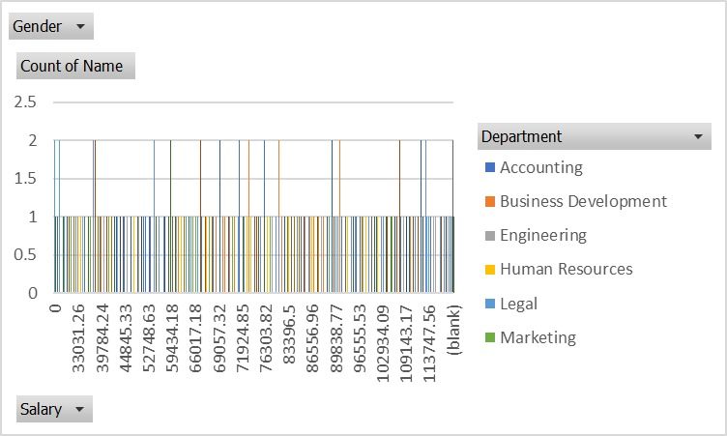
RESULTS
11

Slide 12
conclusion
In conclusion, salary and compensation analysis through Excel data modeling allows for a comprehensive understanding of compensation structures and trends within an organization. By leveraging Excel's data analysis tools, such as pivot tables, charts, and statistical functions, you can identify patterns, disparities, and correlations in compensation data. This analysis helps in benchmarking salaries against industry standards, ensuring internal equity, and making informed decisions regarding adjustments or policy changes. The insights gained can drive strategic compensation planning, enhance employee satisfaction, and improve overall organizational effectiveness.

